Slide 1




Database under source control
Alessandro Alpi (@suxstellino)
Data Platform MVP since 2008
alessandro.alpi@engageitservices.it

Slide 2
Agenda
DevOps concepts
The Continuous pattern
Source control manager
Database vs Code
Database Development tools and solutions
Conclusions
Q&A

Slide 3

DevOps concept
DevOps is a culture, movement or practice that emphasizes the collaboration and communication of both software developers and other information-technology(IT) professionals while automating the process of software delivery and infrastructure changes. It aims at establishing a culture and environment where building, testing, and releasing software, can happen rapidly, frequently, and more reliably
(source Wikipedia)

Slide 4




We will speak about…
Development teams
We’re writing code and features
Sharing work
We’re creating changesets that will be shared across the team
Automation
Every “checkin” should be automatically built and delivered
Productivity
A repeatable and reliable process will speed up our development

Slide 5
We want reach these goals
Add operations teams
We want to bring our development in environments
Sharing work with them
Operations team must know development stuff and processes
Automation is still needed
We want to be able to write automated delivery processes
Productivity is a must, also here
This is true also for deploying the application

Slide 6
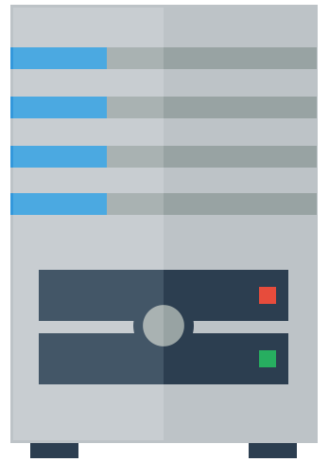

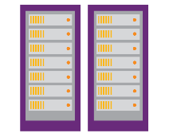




What we need to reach DevOps
IDE
Source Control Manager
(Version control system)
Build server and process
(also for automation)
QA / Unit test process
(automated)
Release processes
(automated and reliable)
Development
Operation
Integration

Slide 7

DevOps and databases
The databases needs development
The databases must be redistributed between teams
The databases must be synced within the development environment
The database will have «changes» associated to «activities»
The database should be automatically tested
The database should be automatically built
The database should be checked for potential drifts
And, of course, it’s a good thing to deploy it ☺

Slide 8
The “Continuous pattern”
Automation of each step
Continuous Integration (with Version Control System)
Integration, at least daily, of the work done
Development team
Continuous Delivery (pre production release with automated builds and tests)
Build server, unit testing frameworks, automatically triggered
Pre production environments
Cooperation with Operation team
Continuous Deployment (automated production release, after acceptance)
Release of the builds which pass UAT and QA tests
Automated processes
Cooperation with Operation team

Slide 9

Database and Continuous Integration
Continuous improvement leads to better software quality
So, Continuous Integration helps us to improve with quality
DEVELOPMENT + SEND
TRIGGERED BUILD
AUTOMATED UNIT TESTS
“DONE” WORK SHARING

Slide 10
Source control manager
The way we can version our database code
Management of versions
Changes of the code (and not only those)
Shared entity during development stages
Core of (automated) delivery
Often used with other tools for managing teams
Provides an interface (also graphic)

Slide 11
Source control manager, why?
History of database items
Safe storage of our files (persistence)
Share development lines within the team
Track of edits, by user
Central point for (automated) database delivery
Central point for (automating) builds and tests
The real needs of every team about the code..

Slide 12
Source control manager, what about databases?
The DB can be a file «inside the application»
The DB is «located on the server»
The DB persists user data
The DB is not all and only code
However, the changes on the DB must be reflected to the whole development team
The Source Control seems «uncomfortable», at first sight..

Slide 13
Code vs Database, are they really different?
The database IS code (programmability, ddl, grant, etc.)
The «domain» tables are like many enums (static data).
The DB should be changed in more development branches.
Linked servers are configurations (like *.config)
The login server are environment configurations
The database persist the data.
It’s not a *source control* problem
Some data should be stored in Source Control Manager

Slide 14
In the end…
Our databases should be under source control management
We can “get the latest version”
We can see the differences between versions
We can integrate our database IDE with the most popular SCM
We can avoid to use a single dev server for workday
How many times did you break the work of the other team members?
Is there any better solution than having our development sandboxes?
Finally we can reduce the gap between DBAs and DEVs (OOOOH! ☺)
Last but not least, we will be ready for continuous improvement:
Continuous integration
DevOps related tasks

Slide 15

A possible solution
Visual Studio Team Serivices (formerly VSOnline)
Source Control Manager in the cloud
Core team management tool also
Engine for automated tasks and releases
Automated builds
Release managements
Team explorer as UI for managing versions/changesets
RedGate SQL Source Control
Versions/changesets tool for SQL Server
Integrated with SSMS IDE

Slide 16
The team explorer
Regardless of the tool we use, Team Explorer allows us to:
Improve management of the changesets
Improve association of changesets to tasks
Improve control on commit/get/sync/pull/checkin phases
Centralize management of checkin policy
Single point for management of the team project
For Red Gate SQL Source Control
Used when in «Working folder» configuration
For Visual Studio Team Services
Used when getting the latest version and when sending changesets

Slide 17
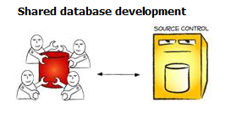
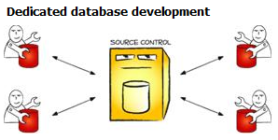

SQL Source Control – Development models
Shared
Dedicated (suggested)
One single dev server
All the team works on the server
Highly possible conflicts
The last changeset wins on everything
Cannot track versions between developers
Workstations are dev servers
Each team member works on its own sandbox
No conflicts during development (only on send phase)
Each check-in is a different changeset
Each check-in is a different database version

Slide 18
SQL Source Control – Link models
Working folder
Integrated with SCM
Working base (in AppData folder)
Analyze differences
Avoid any SQL Server Api call
Working folder (the Visual Studio Workspace)
Store changes
Show pending changes on Team Explorer
Detected items on Team Explorer!
Filesystem based
Two phases for sending: save/checkin
Two phases for getting differences: get/apply
Simple to package
Working base (in AppData folder)
Analyze differences
Avoid any SQL Server Api call
Link with source control url
Store changes remotely
Show pending changes on SSMS
Url based (SCM APIs)
One click checkin on SCM via SSMS
No get, SSMS is sync’ed when getting changes
Simple to package

Slide 19



The real scenario
Sql Server Management Studio IDE
Development
Working folder
File “.sql”
Team Explorer to
Source Control
Code, History and
Changesets
Repository
Save
Send
LINK
Apply
Get

Slide 20
LET’S PLAY
SQL Server Management Studio + Visual Studio Team Services

Slide 21
Advantages using SCM on databases
Simply manage and track fixes
Multiple development environments
Branch the databases as the application
Switch to different versions of the databases
Label the changesets as for the application
Integration with automated tools for deploying
Ready for drift check during deployment
Sync all the team to a certain version of the databases
…much more ☺

Slide 22
Conclusions
Possible consideration
How is our team structured?
Which are the minimum requirements?
How much can I spend?
Can I afford the learning curve if I change IDE?
However, we should really use the Source Control ☺

Slide 23
Questions?
..and, hopefully, answers!

Slide 24
THANK YOU!

Slide 25
Resources
http://www.codinghorror.com/blog/2006/12/is-your-database-under-version-control.html
http://odetocode.com/blogs/scott/archive/2008/01/30/three-rules-for-database-work.aspx
http://odetocode.com/blogs/scott/archive/2008/01/31/versioning-databases-the-baseline.aspx
http://odetocode.com/blogs/scott/archive/2008/02/02/versioning-databases-change-scripts.aspx
http://odetocode.com/blogs/scott/archive/2008/02/02/versioning-databases-views-stored-procedures-and-the-like.aspx
http://odetocode.com/blogs/scott/archive/2008/02/03/versioning-databases-branching-and-merging.aspx
http://www.red-gate.com/products/sql-development/sql-source-control/
http://apexsql.com/sql_tools_source_control.aspx
http://suxstellino.wordpress.com/tag/alm/
http://blogs.dotnethell.it/suxstellino/Category_2927.aspx
http://blogs.msdn.com/b/ssdt/archive/2012/02/02/including-data-in-an-sql-server-database-project.aspx

Slide 26






My work
SQL Server sotto source control
Unit testing con SQL Server
SQL Server Continuous Integration
Virtual chapter su SQL Server e source control
getlatestversion
ALM su getlatestversion.it
Putting our database under source control
Unit testing on SQL Server databases with tSQLt
ALM on docs.com

Slide 27

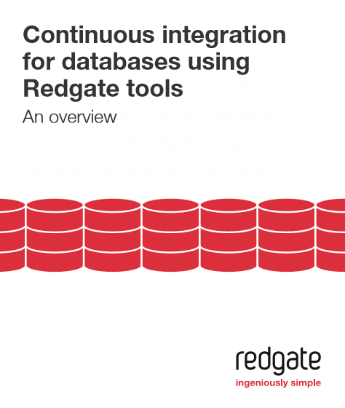
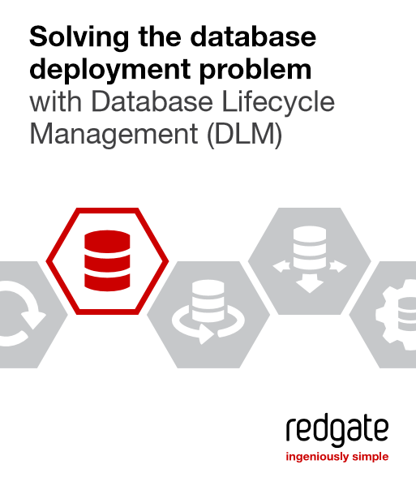
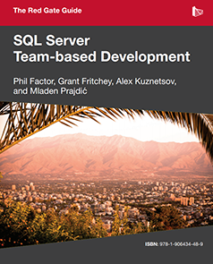
Books
SQL Server Source Control Basics
Continuous Integration for databases
Solving the database deployment problem
SQL Server Team-Based Development

Slide 28
Grazie agli sponsor

